Slide 1
Fundamentals of Analog & Mixed Signal VLSI Design
Basic Building Blocks
Christian Enz
Integrated Circuits Lab (ICLAB), Institute of Electrical and Micro-Engineering (IEM), School of Engineering (STI)
Swiss Federal Institute of Technology, Lausanne (EPFL), Switzerland

Slide 2
Outline
Current mirrors
Cascode stage
Differential pair
Elementary gain cells and source follower
Current references

Slide 3
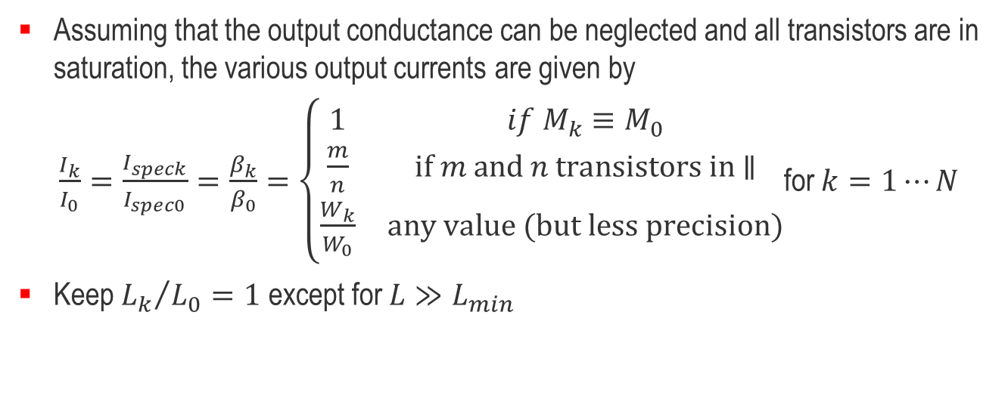
Current Mirrors Principle
Assuming that the output conductance can be neglected and all transistors are in saturation, the various output currents are given by
$\frac{I_{k}}{I_{0}}=\frac{I_{speck}}{I_{spec0}}=\frac{β_{k}}{β_{0}}=\left\{\begin{matrix}1 & if M_{k}≡M_{0} \\ \frac{m}{n} & \text{if} m \text{and} n \text{transistors} \text{in}\text{ ∥} \\ \frac{W_{k}}{W_{0}} & \text{any} \text{value}\text{ (}\text{but} \text{less} \text{precision}\text{)}\end{matrix}\right.$for $k=1⋯N$
Keep ${L_{k}}/{L_{0}}=1$ except for $L≫L_{min}$

Slide 4
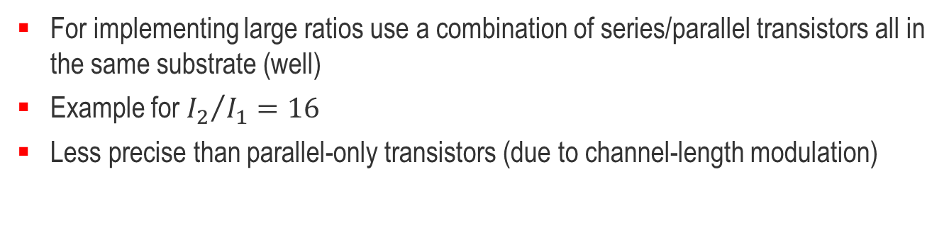
Large Current Ratios
For implementing large ratios use a combination of series/parallel transistors all in the same substrate (well)
Example for ${I_{2}}/{I_{1}}=16$
Less precise than parallel-only transistors (due to channel-length modulation)

Slide 5
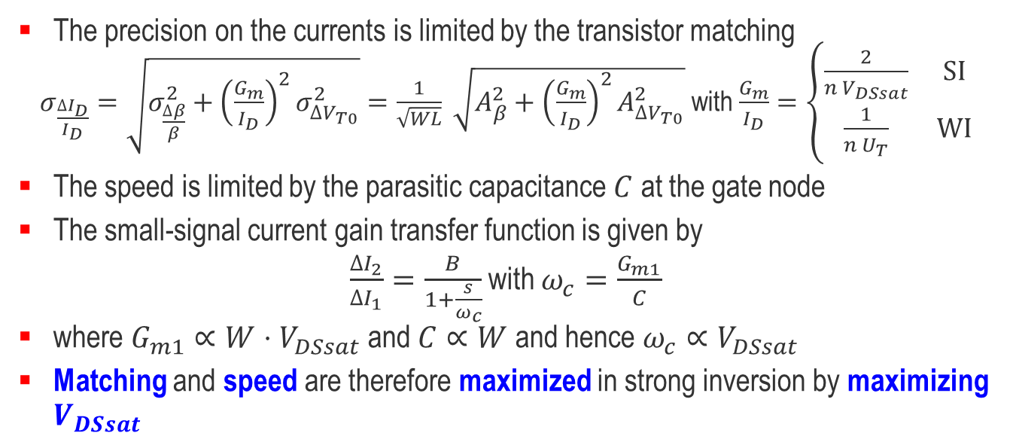
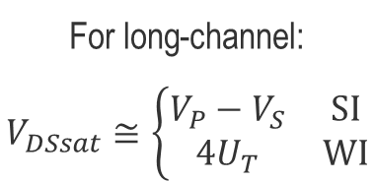
Design Criteria – Precision and Bandwidth
For long-channel:
$$V_{DSsat}≅\left\{\begin{matrix}V_{P}−V_{S} & \text{SI} \\ 4U_{T} & \text{WI}\end{matrix}\right.$$
The precision on the currents is limited by the transistor matching
$σ_{\frac{{∆I}_{D}}{I_{D}}}=\sqrt{σ_{\frac{∆β}{β}}^{2}+{\left(\frac{G_{m}}{I_{D}}\right)}^{2}σ_{{∆V}_{T0}}^{2}}=\frac{1}{\sqrt{WL}} \sqrt{A_{β}^{2}+{\left(\frac{G_{m}}{I_{D}}\right)}^{2}A_{{∆V}_{T0}}^{2}}$ with $\frac{G_{m}}{I_{D}}=\left\{\begin{matrix}\frac{2}{n V_{DSsat}} & \text{SI} \\ \frac{1}{n U_{T}} & \text{WI}\end{matrix}\right.$
The speed is limited by the parasitic capacitance $C$ at the gate node
The small-signal current gain transfer function is given by
$\frac{∆I_{2}}{∆I_{1}}=\frac{B}{1+\frac{s}{ω_{c}}}$ with $ω_{c}=\frac{G_{m1}}{C}$
where $G_{m1}∝W⋅V_{DSsat}$ and $C∝W$ and hence $ω_{c}∝V_{DSsat}$
Matching and speed are therefore maximized in strong inversion by maximizing $V_{DSsat}$

Slide 6
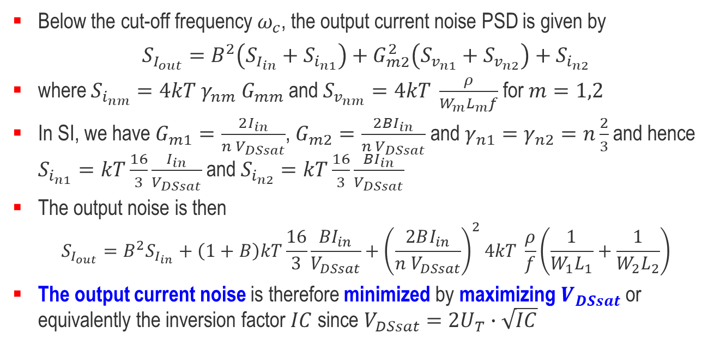
Design Criteria – Noise
Below the cut-off frequency $ω_{c}$, the output current noise PSD is given by
$$S_{I_{out}}=B^{2}\left(S_{I_{in}}+S_{i_{n1}}\right)+G_{m2}^{2}\left(S_{v_{n1}}+S_{v_{n2}}\right)+S_{i_{n2}}$$
where $S_{i_{nm}}=4kT γ_{nm} G_{mm}$ and $S_{v_{nm}}=4kT \frac{ρ}{W_{m}L_{m}f}$ for $m=1,2$
In SI, we have $G_{m1}=\frac{2I_{in}}{n V_{DSsat}}$, $G_{m2}=\frac{2BI_{in}}{n V_{DSsat}}$ and $γ_{n1}=γ_{n2}=n\frac{2}{3}$ and hence $S_{i_{n1}}=kT\frac{16}{3}\frac{I_{in}}{V_{DSsat}}$ and $S_{i_{n2}}=kT\frac{16}{3}\frac{BI_{in}}{V_{DSsat}}$
The output noise is then
$$S_{I_{out}}=B^{2}S_{I_{in}}+\left(1+B\right)kT\frac{16}{3}\frac{BI_{in}}{V_{DSsat}}+{\left(\frac{2BI_{in}}{n V_{DSsat}}\right)}^{2}4kT \frac{ρ}{f}\left(\frac{1}{W_{1}L_{1}}+\frac{1}{W_{2}L_{2}}\right)$$
The output current noise is therefore minimized by maximizing $V_{DSsat}$ or equivalently the inversion factor $IC$ since $V_{DSsat}=2U_{T}∙\sqrt{IC}$

Slide 7
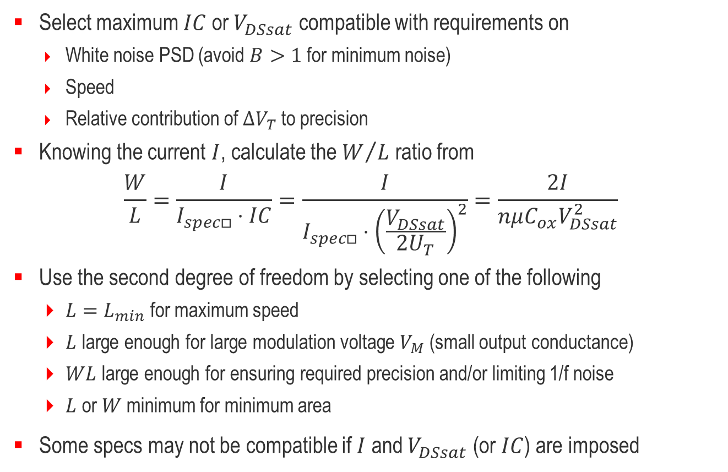
Current Mirrors Design Procedure
Select maximum $IC$ or $V_{DSsat}$ compatible with requirements on
  White noise PSD (avoid $B>1$ for minimum noise)
  Speed
  Relative contribution of ${∆V}_{T}$ to precision
Knowing the current $I$, calculate the $W/L$ ratio from
$$\frac{W}{L}=\frac{I}{I_{spec□}⋅IC}=\frac{I}{I_{spec□}⋅{\left(\frac{V_{DSsat}}{2U_{T}}\right)}^{2}}=\frac{2I}{nμC_{ox}V_{DSsat}^{2}}$$
Use the second degree of freedom by selecting one of the following
  $L=L_{min}$ for maximum speed
  $L$ large enough for large modulation voltage $V_{M}$ (small output conductance)
  $WL$ large enough for ensuring required precision and/or limiting 1/f noise
  $L$ or $W$ minimum for minimum area
Some specs may not be compatible if $I$ and $V_{DSsat}$ (or $IC$) are imposed

Slide 8
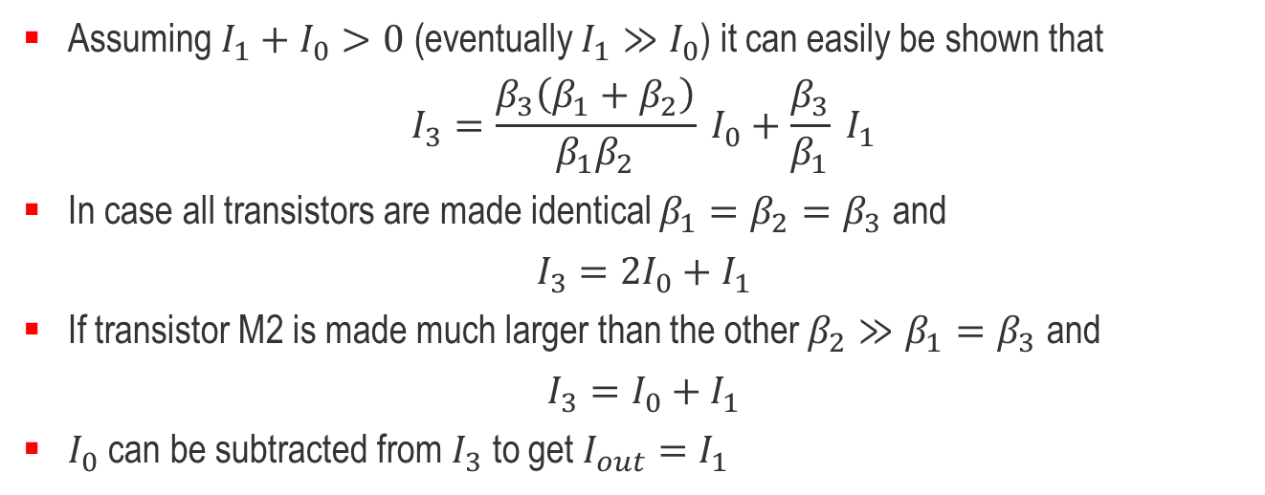
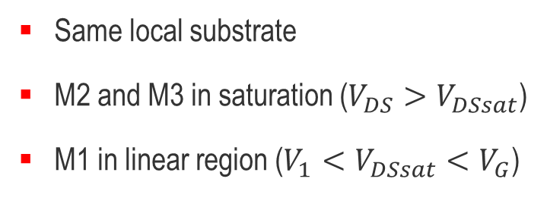
Low-voltage Current Mirror
Same local substrate
M2 and M3 in saturation ($V_{DS}>V_{DSsat}$)
M1 in linear region ($V_{1}<V_{DSsat}<V_{G}$)
Assuming $I_{1}+I_{0}>0$ (eventually $I_{1}≫I_{0}$) it can easily be shown that
$$I_{3}=\frac{β_{3}\left(β_{1}+β_{2}\right)}{β_{1}β_{2}} I_{0}+\frac{β_{3}}{β_{1}} I_{1}$$
In case all transistors are made identical $β_{1}=β_{2}=β_{3}$ and
$$I_{3}=2I_{0}+I_{1}$$
If transistor M2 is made much larger than the other $β_{2}≫β_{1}=β_{3}$ and
$$I_{3}=I_{0}+I_{1}$$
$I_{0}$ can be subtracted from $I_{3}$ to get $I_{out}=I_{1}$

Slide 9
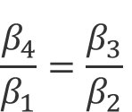
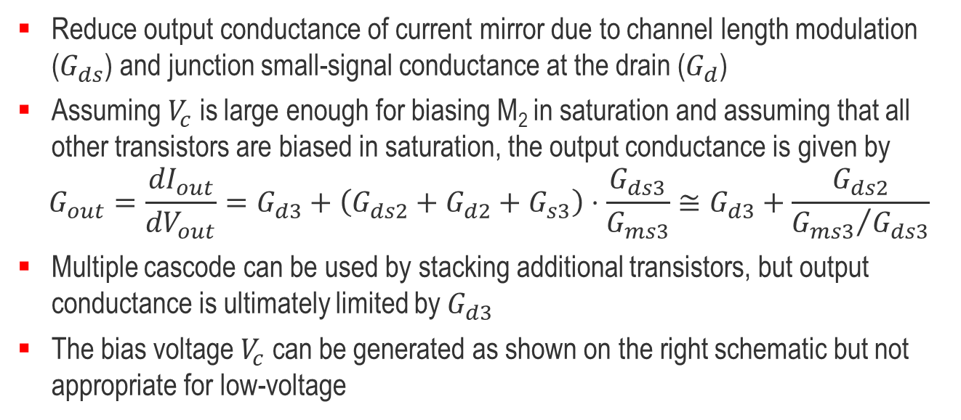
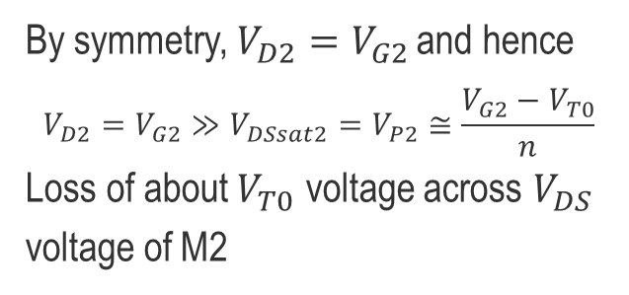
Cascode Current Mirror
$$\frac{β_{4}}{β_{1}}=\frac{β_{3}}{β_{2}}$$
By symmetry, $V_{D2}=V_{G2}$ and hence
$$V_{D2}=V_{G2}≫V_{DSsat2}=V_{P2}≅\frac{V_{G2}−V_{T0}}{n}$$
Loss of about $V_{T0}$ voltage across $V_{DS}$ voltage of M2
Reduce output conductance of current mirror due to channel length modulation ($G_{ds}$) and junction small-signal conductance at the drain ($G_{d}$)
Assuming $V_{c}$ is large enough for biasing M₂ in saturation and assuming that all other transistors are biased in saturation, the output conductance is given by
$$G_{out}=\frac{{dI}_{out}}{{dV}_{out}}=G_{d3}+\left(G_{ds2}+G_{d2}+G_{s3}\right)⋅\frac{G_{ds3}}{G_{ms3}}≅G_{d3}+\frac{G_{ds2}}{{G_{ms3}}/{G_{ds3}}}$$
Multiple cascode can be used by stacking additional transistors, but output conductance is ultimately limited by $G_{d3}$
The bias voltage $V_{c}$ can be generated as shown on the right schematic but not appropriate for low-voltage

Slide 10
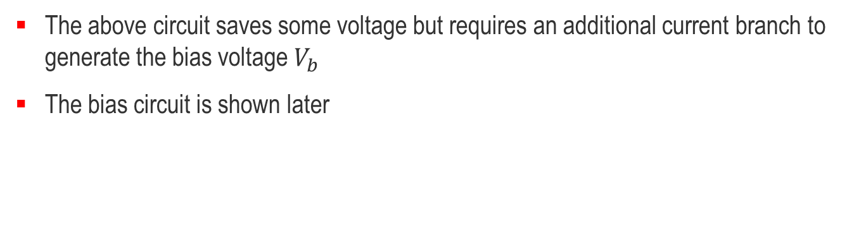
Low-voltage Cascode Current Mirror
The above circuit saves some voltage but requires an additional current branch to generate the bias voltage $V_{b}$
The bias circuit is shown later

Slide 11
Outline
Current mirrors
Cascode stage
Differential pair
Elementary gain cells and source follower
Current references

Slide 12
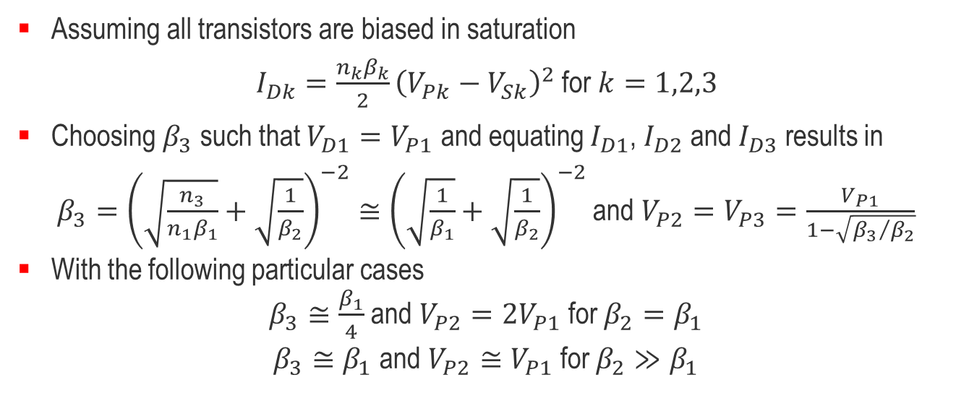
Low-voltage Cascode – Strong Inversion
Assuming all transistors are biased in saturation
$I_{Dk}=\frac{n_{k}β_{k}}{2}{\left(V_{Pk}−V_{Sk}\right)}^{2}$ for $k=1,2,3$
Choosing $β_{3}$ such that $V_{D1}=V_{P1}$ and equating $I_{D1}$, $I_{D2}$ and $I_{D3}$ results in
$β_{3}={\left(\sqrt{\frac{n_{3}}{n_{1}β_{1}}}+\sqrt{\frac{1}{β_{2}}}\right)}^{−2}≅{\left(\sqrt{\frac{1}{β_{1}}}+\sqrt{\frac{1}{β_{2}}}\right)}^{−2}$ and $V_{P2}=V_{P3}=\frac{V_{P1}}{1−\sqrt{{β_{3}}/{β_{2}}}}$
With the following particular cases
$β_{3}≅\frac{β_{1}}{4}$ and $V_{P2}=2V_{P1}$ for $β_{2}=β_{1}$
$β_{3}≅β_{1}$ and $V_{P2}≅V_{P1}$ for $β_{2}≫β_{1}$

Slide 13
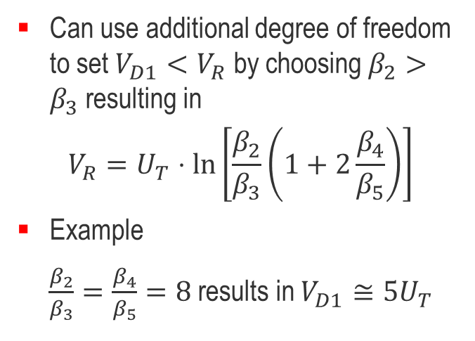
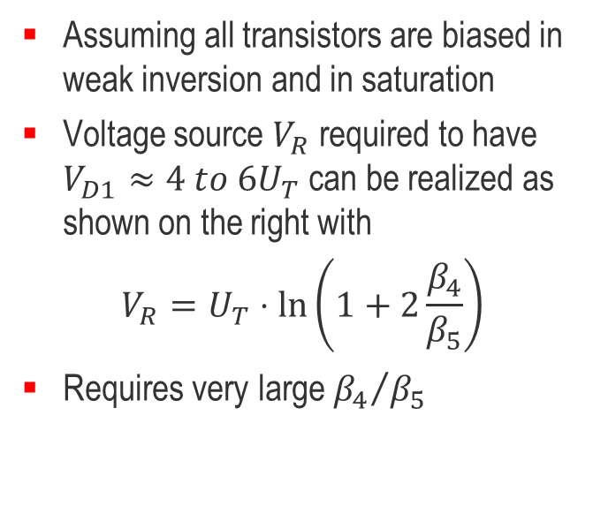
Low-voltage Cascode – Weak Inversion
Assuming all transistors are biased in weak inversion and in saturation
Voltage source $V_{R}$ required to have $V_{D1}≈4 to 6U_{T}$ can be realized as shown on the right with
$$V_{R}=U_{T}⋅\ln\left(1+2\frac{β_{4}}{β_{5}}\right)$$
Requires very large ${β_{4}}/{β_{5}}$
Can use additional degree of freedom to set $V_{D1}<V_{R}$ by choosing $β_{2}>β_{3}$ resulting in
$$V_{R}=U_{T}⋅\ln\left[\frac{β_{2}}{β_{3}}\left(1+2\frac{β_{4}}{β_{5}}\right)\right]$$
Example
$\frac{β_{2}}{β_{3}}=\frac{β_{4}}{β_{5}}=8$ results in $V_{D1}≅5U_{T}$

Slide 14
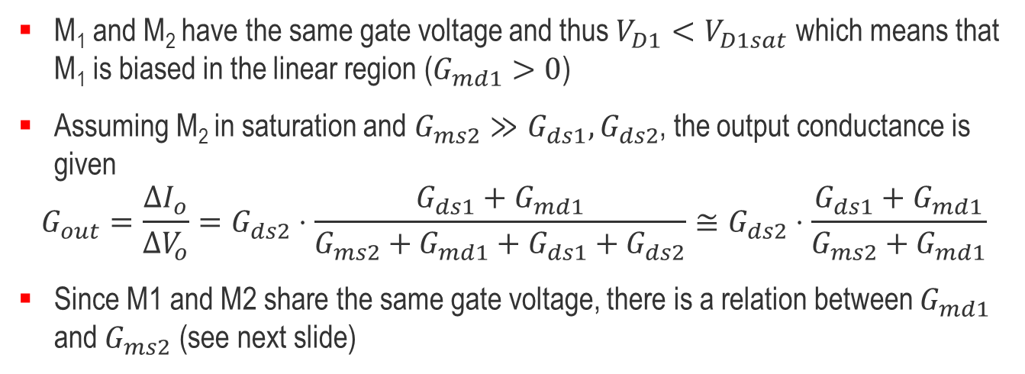
Pseudo-cascade or “Poor Man’s Cascode” (1/2)
M₁ and M₂ have the same gate voltage and thus $V_{D1}<V_{D1sat}$ which means that M₁ is biased in the linear region ($G_{md1}>0$)
Assuming M₂ in saturation and $G_{ms2}≫G_{ds1},G_{ds2}$, the output conductance is given
$$G_{out}=\frac{{∆I}_{o}}{{∆V}_{o}}=G_{ds2}⋅\frac{G_{ds1}+G_{md1}}{G_{ms2}+G_{md1}+G_{ds1}+G_{ds2}}≅G_{ds2}⋅\frac{G_{ds1}+G_{md1}}{G_{ms2}+G_{md1}}$$
Since M1 and M2 share the same gate voltage, there is a relation between $G_{md1}$ and $G_{ms2}$ (see next slide)

Slide 15
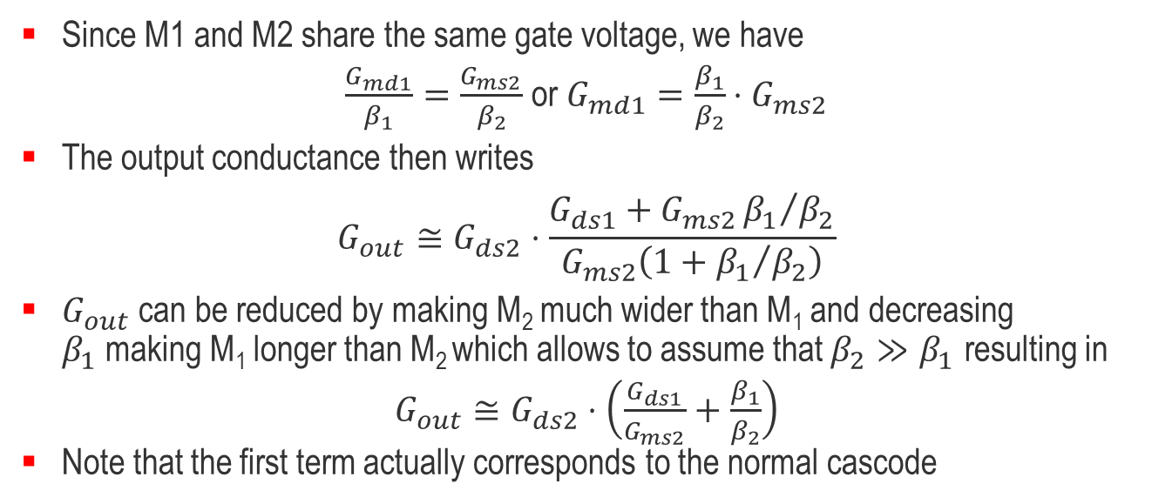
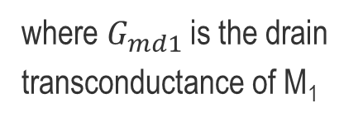
Pseudo-cascade or “Poor Man’s Cascode” (2/2)
where $G_{md1}$ is the drain transconductance of M₁
V
V_{D1}=V_{S2}
V_{P}
Since M1 and M2 share the same gate voltage, we have
$\frac{G_{md1}}{β_{1}}=\frac{G_{ms2}}{β_{2}}$ or $G_{md1}=\frac{β_{1}}{β_{2}}⋅G_{ms2}$
The output conductance then writes
$$G_{out}≅G_{ds2}⋅\frac{G_{ds1}+G_{ms2}{β_{1}}/{β_{2}}}{G_{ms2}\left(1+{β_{1}}/{β_{2}}\right)}$$
$G_{out}$ can be reduced by making M₂ much wider than M₁ and decreasing $β_{1}$making M₁ longer than M₂ which allows to assume that $β_{2}≫β_{1}$ resulting in
$G_{out}≅G_{ds2}⋅$ $\left(\frac{G_{ds1}}{G_{ms2}}+\frac{β_{1}}{β_{2}}\right)$
Note that the first term actually corresponds to the normal cascode

Slide 16
Outline
Current mirrors
Cascode stage
Differential pair
Elementary gain cells and source follower
Current references

Slide 17
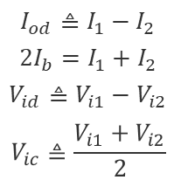
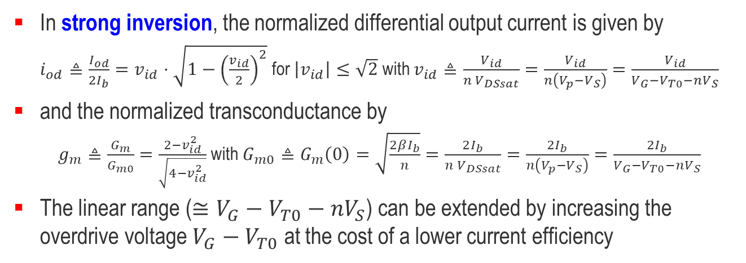
Differential Pair – Strong Inversion
$$I_{od}≜I_{1}−I_{2}$$
$$2I_{b}=I_{1}+I_{2}$$
$$V_{id}≜V_{i1}−V_{i2}$$
$$V_{ic}≜\frac{V_{i1}+V_{i2}}{2}$$
In strong inversion, the normalized differential output current is given by
$i_{od}≜\frac{I_{od}}{2I_{b}}=v_{id}⋅\sqrt{1−{\left(\frac{v_{id}}{2}\right)}^{2}}$ for $\left|v_{id}\right|≤\sqrt{2}$ with $v_{id}≜\frac{V_{id}}{n V_{DSsat}}=\frac{V_{id}}{n\left(V_{p}−V_{S}\right)}=\frac{V_{id}}{V_{G}−V_{T0}−nV_{S}}$
and the normalized transconductance by
$g_{m}≜\frac{G_{m}}{G_{m0}}=\frac{2−v_{id}^{2}}{\sqrt{4−v_{id}^{2}}}$ with $G_{m0}≜G_{m}\left(0\right)=\sqrt{\frac{2βI_{b}}{n}}=\frac{2I_{b}}{n V_{DSsat}}=\frac{2I_{b}}{n\left(V_{p}−V_{S}\right)}=\frac{2I_{b}}{V_{G}−V_{T0}−nV_{S}}$
The linear range ($≅V_{G}−V_{T0}−nV_{S}$) can be extended by increasing the overdrive voltage $V_{G}−V_{T0}$ at the cost of a lower current efficiency

Slide 18
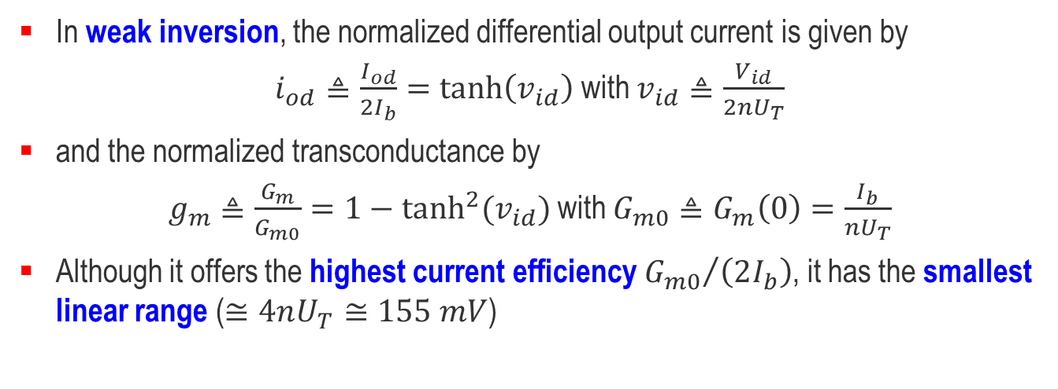
Differential Pair – Weak Inversion
$$I_{od}≜I_{1}−I_{2}$$
$$2I_{b}=I_{1}+I_{2}$$
$$V_{id}≜V_{i1}−V_{i2}$$
$$V_{ic}≜\frac{V_{i1}+V_{i2}}{2}$$
In weak inversion, the normalized differential output current is given by
$i_{od}≜\frac{I_{od}}{2I_{b}}=\tanh\left(v_{id}\right)$ with $v_{id}≜\frac{V_{id}}{2nU_{T}}$
and the normalized transconductance by
$g_{m}≜\frac{G_{m}}{G_{m0}}=1−\tanh^{2}(v_{id})$ with $G_{m0}≜G_{m}\left(0\right)=\frac{I_{b}}{nU_{T}}$
Although it offers the highest current efficiency ${G_{m0}}/{\left(2I_{b}\right)}$, it has the smallest linear range ($≅4nU_{T}≅155 mV$)

Slide 19
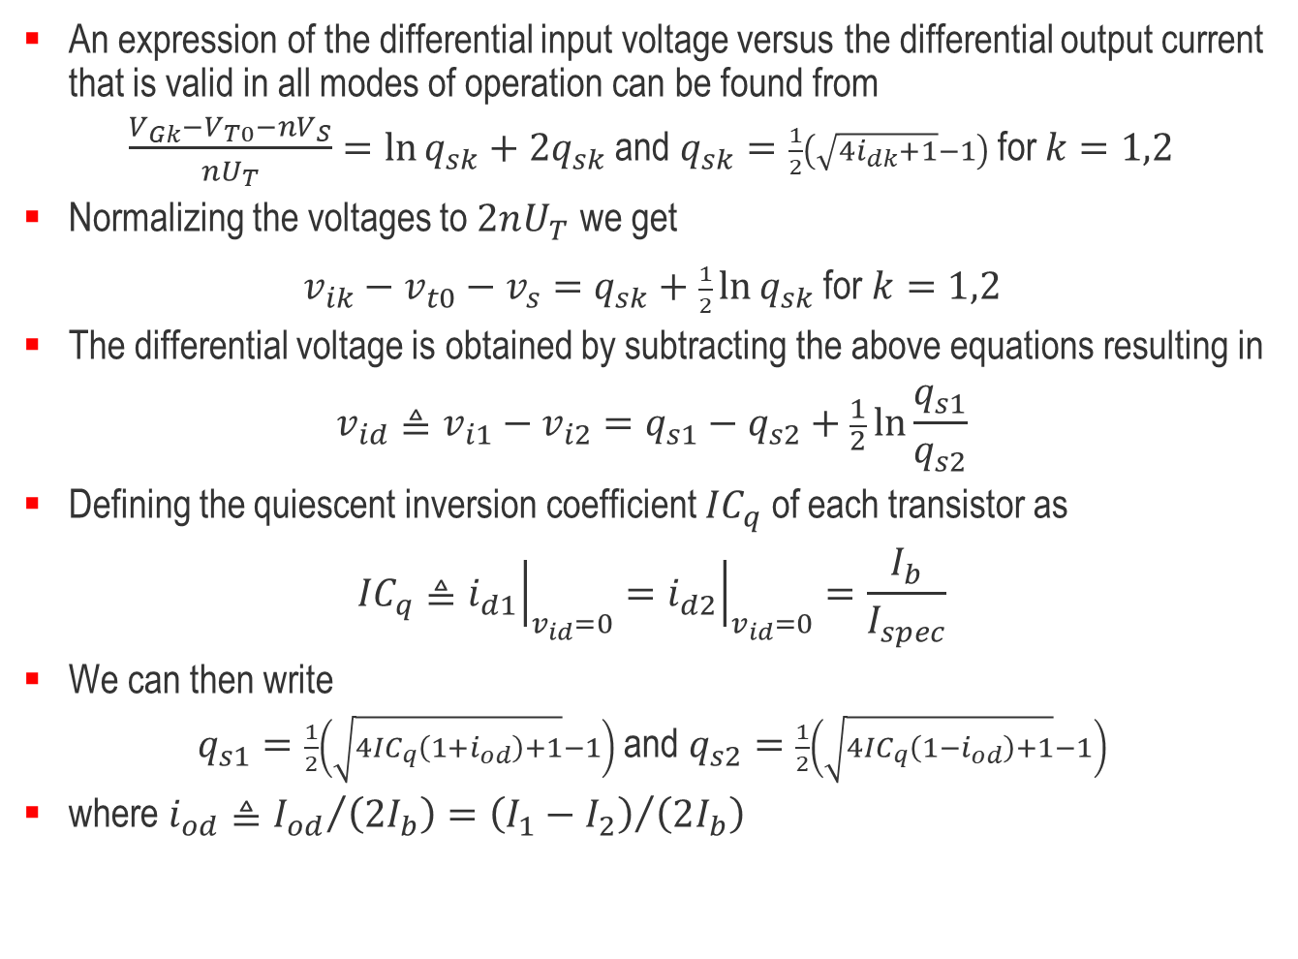
Differential Pair – In All Modes of Operation
An expression of the differential input voltage versus the differential output current that is valid in all modes of operation can be found from
$\frac{V_{Gk}−V_{T0}−nV_{S}}{nU_{T}}=\ln{q_{sk}}+2q_{sk}$ and $q_{sk}=\frac{1}{2}\left(\sqrt{4i_{dk}+1}−1\right)$ for $k=1,2$
Normalizing the voltages to $2nU_{T}$ we get
$v_{ik}−v_{t0}−v_{s}=q_{sk}+\frac{1}{2}\ln{q_{sk}}$ for $k=1,2$
The differential voltage is obtained by subtracting the above equations resulting in
$$v_{id}≜v_{i1}−v_{i2}=q_{s1}−q_{s2}+\frac{1}{2}\ln{\frac{q_{s1}}{q_{s2}}}$$
Defining the quiescent inversion coefficient ${IC}_{q}$ of each transistor as
$${IC}_{q}≜{\left.i_{d1}\right|}_{v_{id}=0}={\left.i_{d2}\right|}_{v_{id}=0}=\frac{I_{b}}{I_{spec}}$$
We can then write
$q_{s1}=\frac{1}{2}\left(\sqrt{4{IC}_{q}\left(1+i_{od}\right)+1}−1\right)$ and $q_{s2}=\frac{1}{2}\left(\sqrt{4{IC}_{q}\left(1−i_{od}\right)+1}−1\right)$
where $i_{od}≜{I_{od}}/{\left(2I_{b}\right)}={\left(I_{1}−I_{2}\right)}/{\left(2I_{b}\right)}$

Slide 20
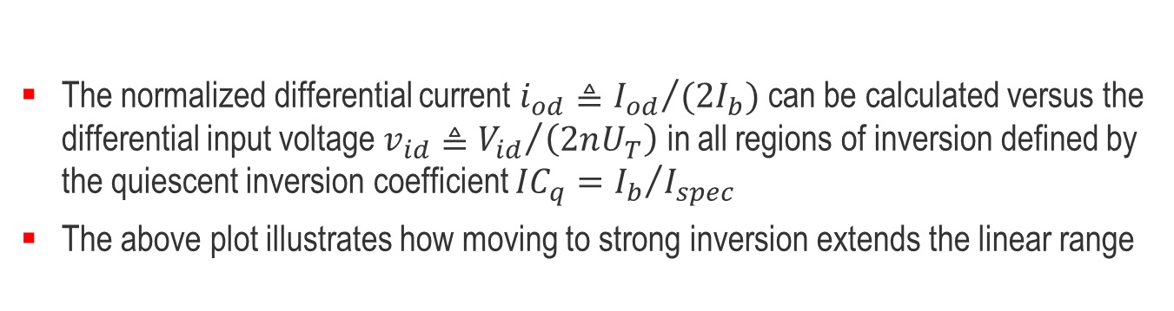
Differential Pair – In All Modes of Operation
$$I_{od}≜I_{1}−I_{2}$$
$$2I_{b}=I_{1}+I_{2}$$
$$V_{id}≜V_{i1}−V_{i2}$$
$$V_{ic}≜\frac{V_{i1}+V_{i2}}{2}$$
The normalized differential current $i_{od}≜{I_{od}}/{(2I_{b})}$ can be calculated versus the differential input voltage $v_{id}≜{V_{id}}/{\left(2nU_{T}\right)}$ in all regions of inversion defined by the quiescent inversion coefficient ${IC}_{q}={I_{b}}/{I_{spec}}$
The above plot illustrates how moving to strong inversion extends the linear range

Slide 21
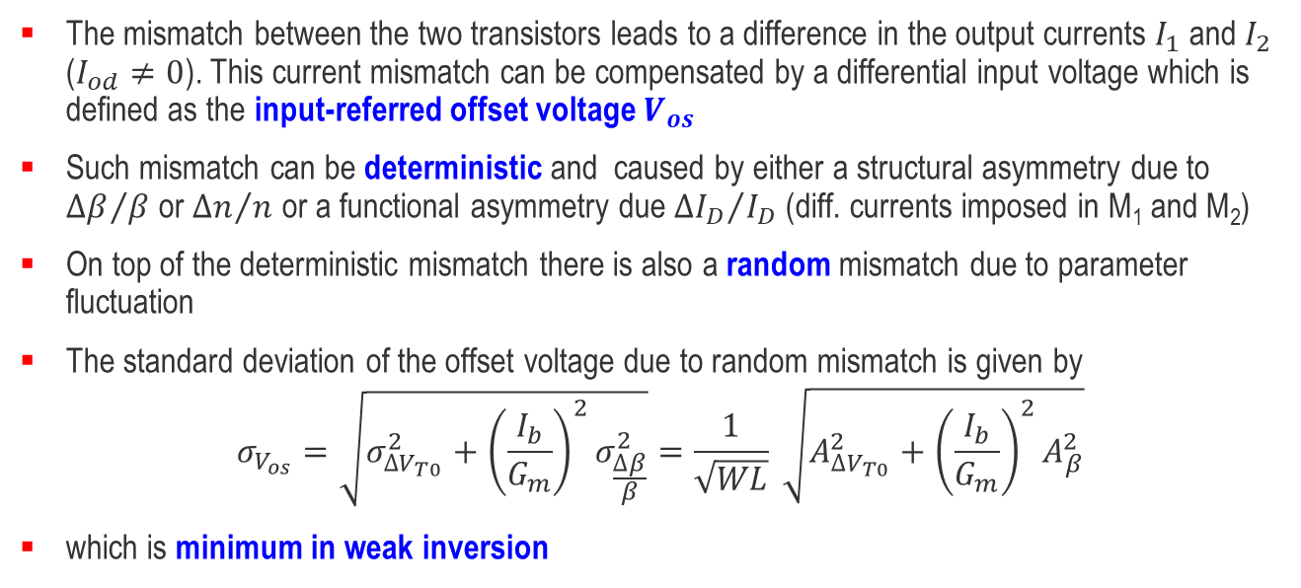
Effects of Asymmetries – Input Offset Voltage
I_{od}
V_{id}
V_{os}
The mismatch between the two transistors leads to a difference in the output currents $I_{1}$ and $I_{2}$ ($I_{od}≠0$). This current mismatch can be compensated by a differential input voltage which is defined as the input-referred offset voltage $V_{os}$
Such mismatch can be deterministic and caused by either a structural asymmetry due to ${∆β}/β$ or ${∆n}/n$ or a functional asymmetry due ${∆I_{D}}/{I_{D}}$ (diff. currents imposed in M₁ and M₂)
On top of the deterministic mismatch there is also a random mismatch due to parameter fluctuation
The standard deviation of the offset voltage due to random mismatch is given by
$$σ_{V_{os}}=\sqrt{σ_{{∆V}_{T0}}^{2}+{\left(\frac{I_{b}}{G_{m}}\right)}^{2}σ_{\frac{∆β}{β}}^{2}}=\frac{1}{\sqrt{WL}} \sqrt{A_{{∆V}_{T0}}^{2}+{\left(\frac{I_{b}}{G_{m}}\right)}^{2}A_{β}^{2}}$$
which is minimum in weak inversion

Slide 22
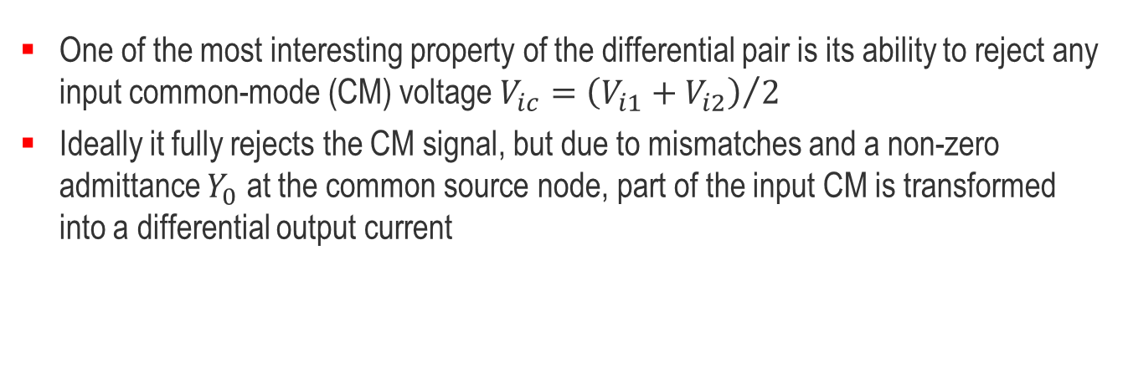
Effects of Asymmetries – CM Input Voltage to DM Output Current
One of the most interesting property of the differential pair is its ability to reject any input common-mode (CM) voltage $V_{ic}={\left(V_{i1}+V_{i2}\right)}/2$
Ideally it fully rejects the CM signal, but due to mismatches and a non-zero admittance $Y_{0}$ at the common source node, part of the input CM is transformed into a differential output current

Slide 23
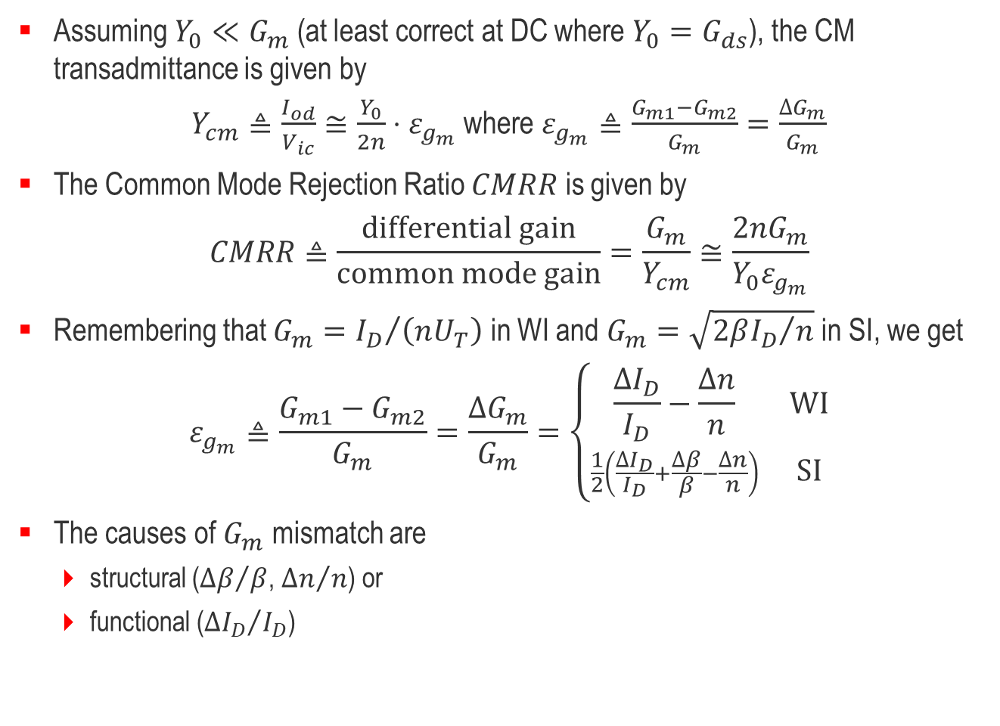
Effects of Asymmetries – Common Mode Rejection Ratio
Assuming $Y_{0}≪G_{m}$ (at least correct at DC where $Y_{0}=G_{ds}$), the CM transadmittance is given by
$Y_{cm}≜\frac{I_{od}}{V_{ic}}≅\frac{Y_{0}}{2n}⋅ε_{g_{m}}$ where $ε_{g_{m}}≜\frac{G_{m1}−G_{m2}}{G_{m}}=\frac{∆G_{m}}{G_{m}}$
The Common Mode Rejection Ratio $CMRR$ is given by
$$CMRR≜\frac{\text{differential} \text{gain}}{\text{common} \text{mode} \text{gain}}=\frac{G_{m}}{Y_{cm}}≅\frac{2nG_{m}}{Y_{0}ε_{g_{m}}}$$
Remembering that $G_{m}={I_{D}}/{\left(nU_{T}\right)}$ in WI and $G_{m}=\sqrt{{2βI_{D}}/n}$ in SI, we get
$$ε_{g_{m}}≜\frac{G_{m1}−G_{m2}}{G_{m}}=\frac{∆G_{m}}{G_{m}}=\left\{\begin{matrix}\frac{∆I_{D}}{I_{D}}−\frac{∆n}{n} & \text{WI} \\ \frac{1}{2}\left(\frac{∆I_{D}}{I_{D}}+\frac{∆β}{β}−\frac{∆n}{n}\right) & \text{SI}\end{matrix}\right.$$
The causes of $G_{m}$ mismatch are
  structural (${∆β}/β$, ${∆n}/n$) or
  functional (${∆I_{D}}/{I_{D}}$)

Slide 24
Outline
Current mirrors
Cascode stage
Differential pair
Elementary gain cells and source follower
Current references

Slide 25
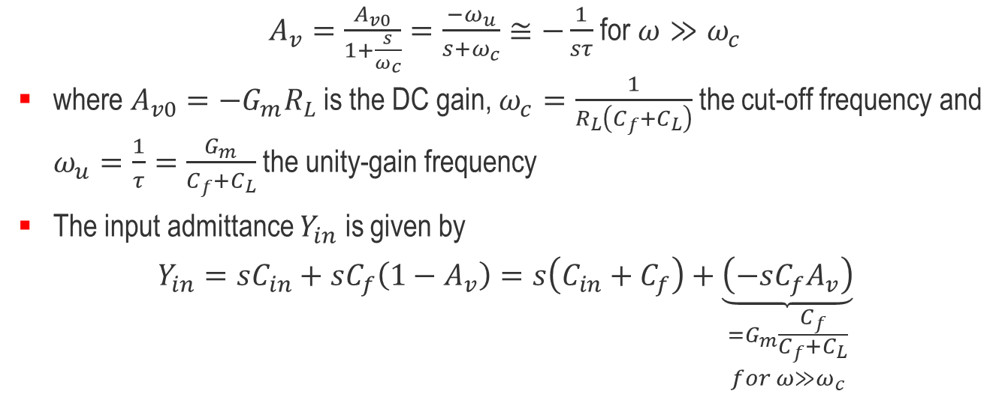
Elementary Voltage-gain Cells
DC Transfer Characteristic
Small-signal Transfer Function
V_{out}
|A_{v}|
V_{DD}
|A_{v0}|
slope A_{v0}
V_{in}
1
ω
_{(log)}
ω_{c}
ω_{u}
$A_{v}=\frac{A_{v0}}{1+\frac{s}{ω_{c}}}=\frac{−ω_{u}}{s+ω_{c}}≅−\frac{1}{sτ}$ for $ω≫ω_{c}$
where $A_{v0}=−G_{m}R_{L}$ is the DC gain, $ω_{c}=\frac{1}{R_{L}\left(C_{f}+C_{L}\right)}$ the cut-off frequency and $ω_{u}=\frac{1}{τ}=\frac{G_{m}}{C_{f}+C_{L}}$ the unity-gain frequency
The input admittance $Y_{in}$ is given by
$$Y_{in}=sC_{in}+sC_{f}\left(1−A_{v}\right)=s\left(C_{in}+C_{f}\right)+\underset{\begin{aligned}=G_{m}\frac{C_{f}}{C_{f}+C_{L}} \\ for ω≫ω_{c}\end{aligned}}{\underbrace{\left(−sC_{f}A_{v}\right)}}$$

Slide 26
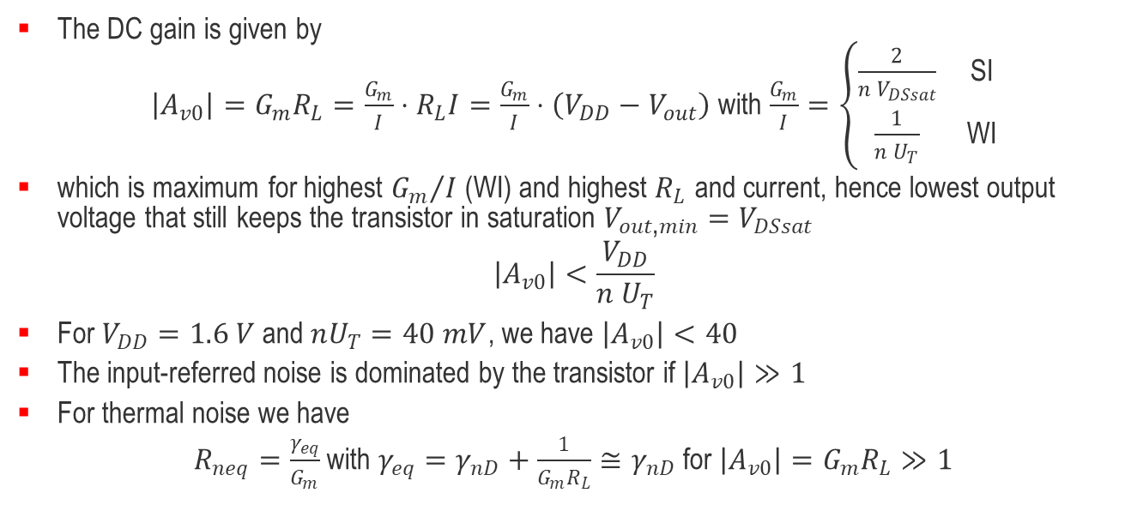
Gain Cell with Resistor Load
V_{out}
V_{out}=V_{DD}−R_{L}·I(V_{in})
V_{DD}
|A_{v0max}|
V_{out-min}
V_{in}
The DC gain is given by
$\left|A_{v0}\right|=G_{m}R_{L}=\frac{G_{m}}{I}⋅R_{L}I=\frac{G_{m}}{I}⋅\left(V_{DD}−V_{out}\right)$ with $\frac{G_{m}}{I}=\left\{\begin{matrix}\frac{2}{n V_{DSsat}} & \text{SI} \\ \frac{1}{n U_{T}} & \text{WI}\end{matrix}\right.$
which is maximum for highest ${G_{m}}/I$ (WI) and highest $R_{L}$ and current, hence lowest output voltage that still keeps the transistor in saturation $V_{out\text{,}min}=V_{DSsat}$
$$\left|A_{v0}\right|<\frac{V_{DD}}{n U_{T}}$$
For $V_{DD}=1.6 V$ and $nU_{T}=40 mV$, we have $\left|A_{v0}\right|<40$
The input-referred noise is dominated by the transistor if $\left|A_{v0}\right|≫1$
For thermal noise we have
$R_{neq}=\frac{γ_{eq}}{G_{m}}$ with $γ_{eq}=γ_{nD}+\frac{1}{G_{m}R_{L}}≅γ_{nD}$ for $\left|A_{v0}\right|=G_{m}R_{L}≫1$

Slide 27
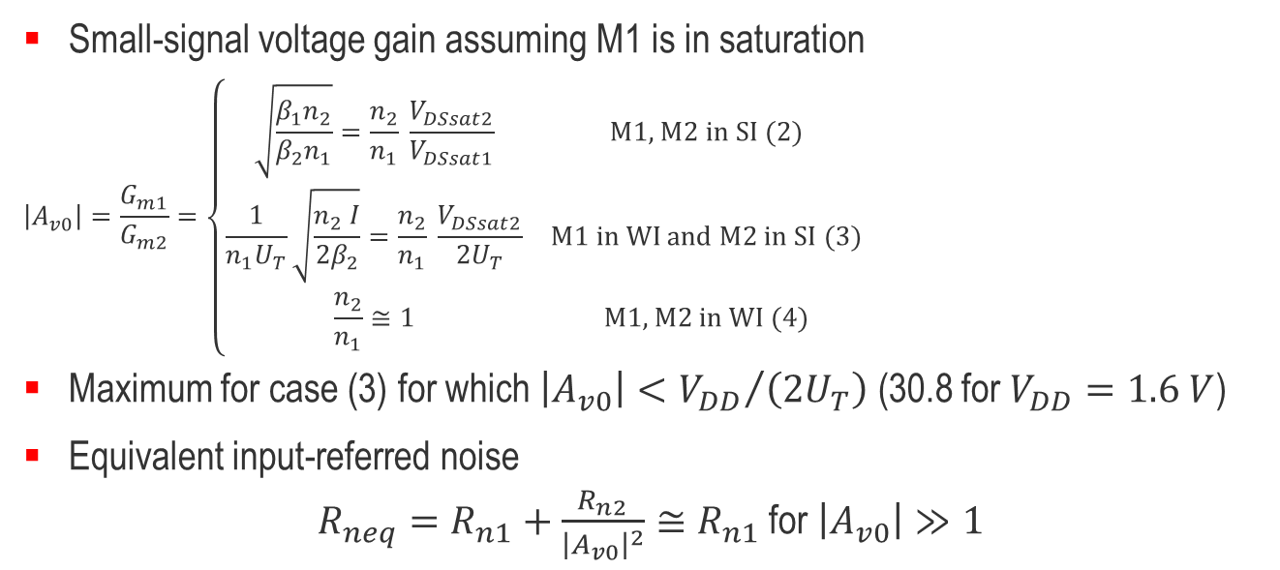
Gain Cell with Diode-connected Load
V_{out}
I₂
1
4
I₁
V_{DD}
3
2
M1 leaves
saturation
2-3-4
1
V_{out}
V_{in}
V_{DD}
V_{T0}
Small-signal voltage gain assuming M1 is in saturation
$$\left|A_{v0}\right|=\frac{G_{m1}}{G_{m2}}=\left\{\begin{matrix}\sqrt{\frac{β_{1}n_{2}}{β_{2}n_{1}}}=\frac{n_{2}}{n_{1}} \frac{V_{DSsat2}}{V_{DSsat1}} & \text{M}\text{1, }\text{M}\text{2 }\text{in} \text{SI}\text{ (2)} \\ \frac{1}{n_{1}U_{T}}\sqrt{\frac{n_{2} I}{{2β}_{2}}}=\frac{n_{2}}{n_{1}} \frac{V_{DSsat2}}{2U_{T}} & \text{M}\text{1 }\text{in} \text{WI} \text{and} \text{M}\text{2 }\text{in} \text{SI}\text{ (3)} \\ \frac{n_{2}}{n_{1}}≅1 & \text{M}\text{1, }\text{M}\text{2 }\text{in} \text{W}\text{I}\text{ (4)}\end{matrix}\right.$$
Maximum for case (3) for which $\left|A_{v0}\right|<{V_{DD}}/{\left(2U_{T}\right)}$ (30.8 for $V_{DD}=1.6 V$)
Equivalent input-referred noise
$R_{neq}=R_{n1}+\frac{R_{n2}}{{\left|A_{v0}\right|}^{2}}≅R_{n1}$ for $\left|A_{v0}\right|≫1$
Region | M1 | M2
1 | SI lin | SI sat
2 | SI sat | SI sat
3 | WI sat | SI sat
4 | WI sat | WI sat

Slide 28
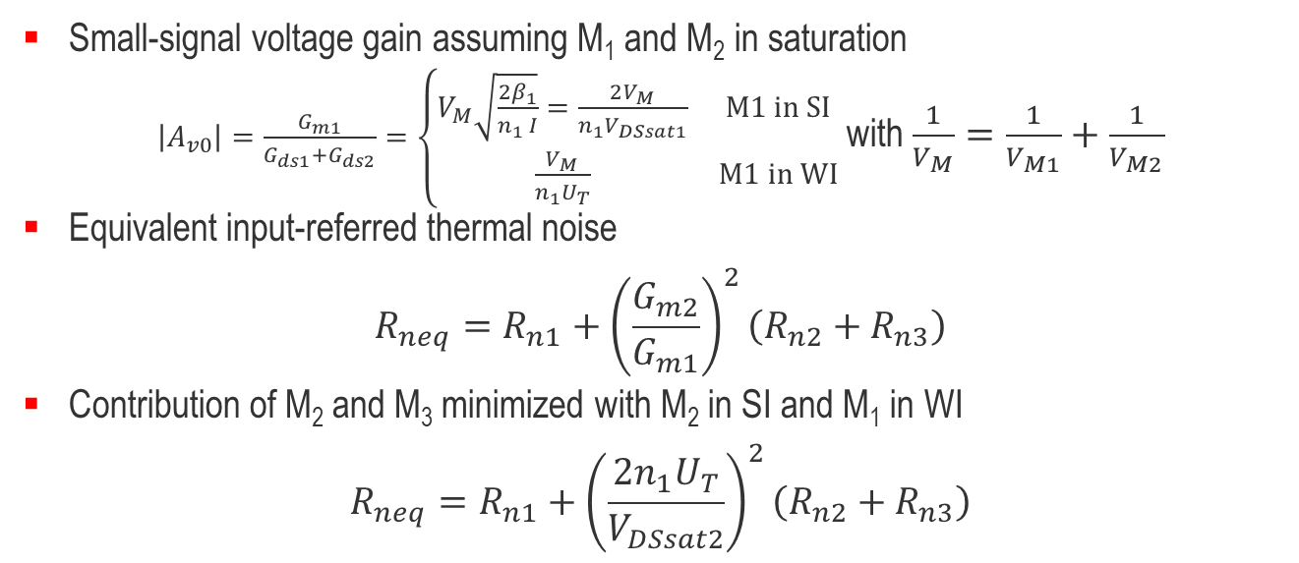
Gain Cell with Current Source Load
V_{out}
I₁
V_{DD}
3
1
M1 and M2
in saturation
I₂
3
2
1
V_{out}
V_{in}
V_{DD}
Small-signal voltage gain assuming M₁ and M₂ in saturation
$\left|A_{v0}\right|=\frac{G_{m1}}{G_{ds1}+G_{ds2}}=\left\{\begin{matrix}V_{M}\sqrt{\frac{2β_{1}}{n_{1} I}}=\frac{2V_{M}}{n_{1}V_{DSsat1}} & \text{M}\text{1 }\text{in} \text{SI} \\ \frac{V_{M}}{n_{1}U_{T}} & \text{M}\text{1 }\text{in} \text{WI}\end{matrix}\right.$ with $\frac{1}{V_{M}}=\frac{1}{V_{M1}}+\frac{1}{V_{M2}}$
Equivalent input-referred thermal noise
$$R_{neq}=R_{n1}+{\left(\frac{G_{m2}}{G_{m1}}\right)}^{2}\left(R_{n2}+R_{n3}\right)$$
Contribution of M₂ and M₃ minimized with M₂ in SI and M₁ in WI
$$R_{neq}=R_{n1}+{\left(\frac{{2n}_{1}U_{T}}{V_{DSsat2}}\right)}^{2}\left(R_{n2}+R_{n3}\right)$$

Slide 29
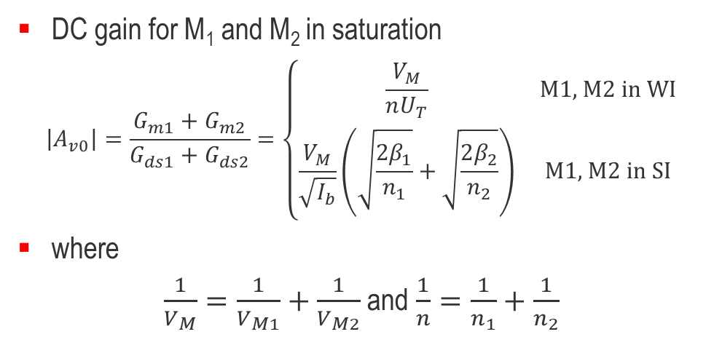
CMOS Inverter as a Gain Cell
V_{out}
I₂
V_{DD}
3
I₁
1
2
3
1
V_{out}
V_{in}
V_{DD}
I₂
I₁
DC gain for M₁ and M₂ in saturation
$$\left|A_{v0}\right|=\frac{G_{m1}+G_{m2}}{G_{ds1}+G_{ds2}}=\left\{\begin{matrix}\frac{V_{M}}{nU_{T}} & \text{M}\text{1, }\text{M}\text{2 }\text{in} \text{W}\text{I} \\ \frac{V_{M}}{\sqrt{I_{b}}}\left(\sqrt{\frac{2β_{1}}{n_{1}}}+\sqrt{\frac{2β_{2}}{n_{2}}}\right) & \text{M}\text{1, }\text{M}\text{2 }\text{in} \text{S}\text{I}\end{matrix}\right.$$
where
$\frac{1}{V_{M}}=\frac{1}{V_{M1}}+\frac{1}{V_{M2}}$ and $\frac{1}{n}=\frac{1}{n_{1}}+\frac{1}{n_{2}}$
I_{b}
I_{L}
I_{L}
V_{in}
V_{b}
V_{DD}

Slide 30
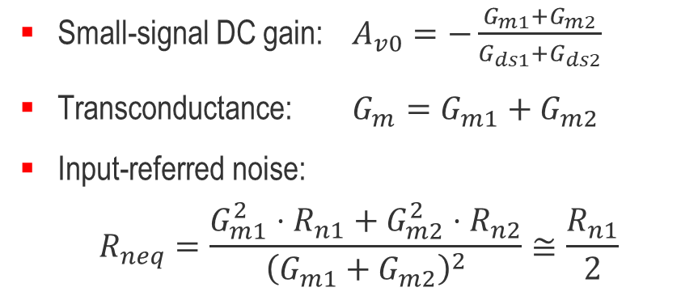
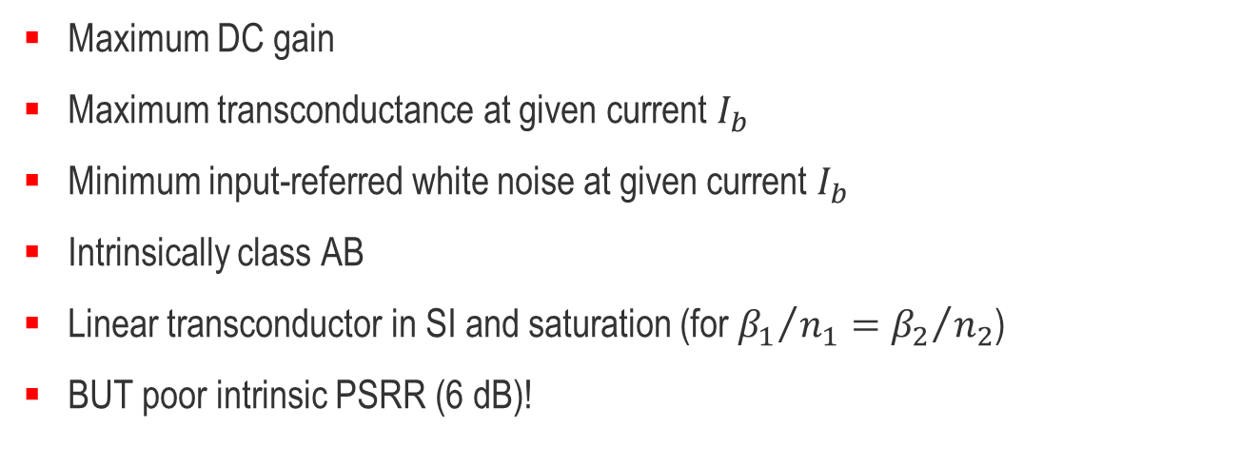
CMOS Inverter as a Gain Cell
Small-signal DC gain: $A_{v0}=−\frac{G_{m1}+G_{m2}}{G_{ds1}+G_{ds2}}$
Transconductance: $G_{m}=G_{m1}+G_{m2}$
Input-referred noise:
$$R_{neq}=\frac{G_{m1}^{2}⋅R_{n1}+G_{m2}^{2}⋅R_{n2}}{{\left(G_{m1}+G_{m2}\right)}^{2}}≅\frac{R_{n1}}{2}$$
Maximum DC gain
Maximum transconductance at given current $I_{b}$
Minimum input-referred white noise at given current $I_{b}$
Intrinsically class AB
Linear transconductor in SI and saturation (for ${β_{1}}/{n_{1}}={β_{2}}/{n_{2}}$)
BUT poor intrinsic PSRR (6 dB)!

Slide 31
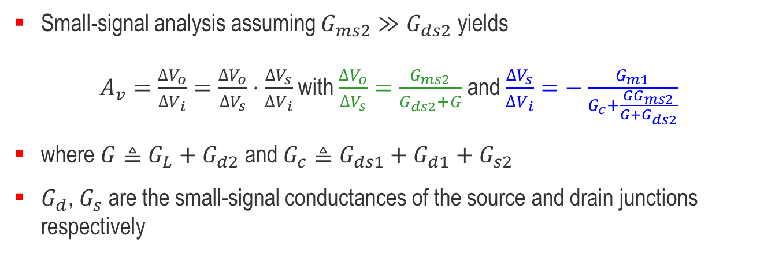
Cascode Gain Cell
Direct cascode
Folded cascode
Small-signal analysis assuming $G_{ms2}≫G_{ds2}$ yields
$A_{v}=\frac{∆V_{o}}{∆V_{i}}=\frac{∆V_{o}}{∆V_{s}}⋅\frac{∆V_{s}}{∆V_{i}}$ with $\frac{∆V_{o}}{∆V_{s}}=\frac{G_{ms2}}{G_{ds2}+G}$ and $\frac{∆V_{s}}{∆V_{i}}=−\frac{G_{m1}}{G_{c}+\frac{GG_{ms2}}{G+G_{ds2}}}$
where $G≜G_{L}+G_{d2}$ and $G_{c}≜G_{ds1}+G_{d1}+G_{s2}$
$G_{d}$, $G_{s}$ are the small-signal conductances of the source and drain junctions respectively

Slide 32
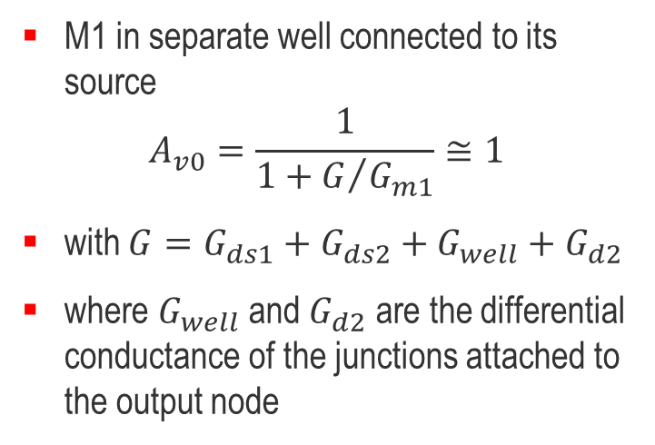
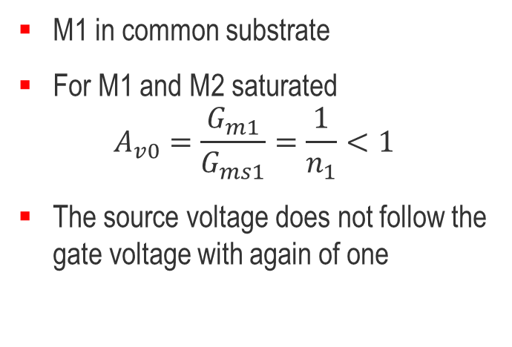
Source Follower
M1 in common substrate
For M1 and M2 saturated
$$A_{v0}=\frac{G_{m1}}{G_{ms1}}=\frac{1}{n_{1}}<1$$
The source voltage does not follow the gate voltage with again of one
M1 in separate well connected to its source
$$A_{v0}=\frac{1}{1+G/{G_{m1}}}≅1$$
with $G=G_{ds1}+G_{ds2}+G_{well}+G_{d2}$
where $G_{well}$ and $G_{d2}$ are the differential conductance of the junctions attached to the output node

Slide 33
Outline
Current mirrors
Cascode stage
Differential pair
Elementary gain cells and source follower
Current references

Slide 34
Current Generation – The Vittoz Current Reference
No "built-in" current available in silicon
  No way to generate a current that is independent of process parameters
  Should be independent of the supply voltage

Slide 35
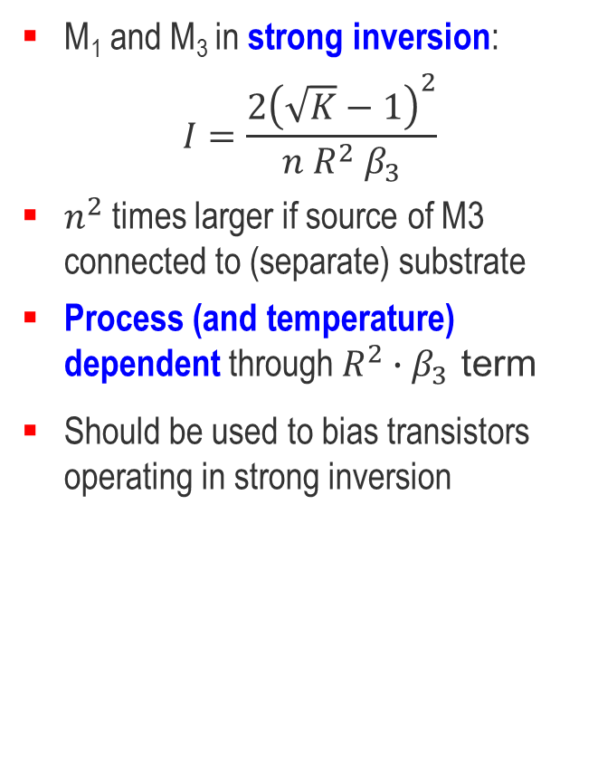
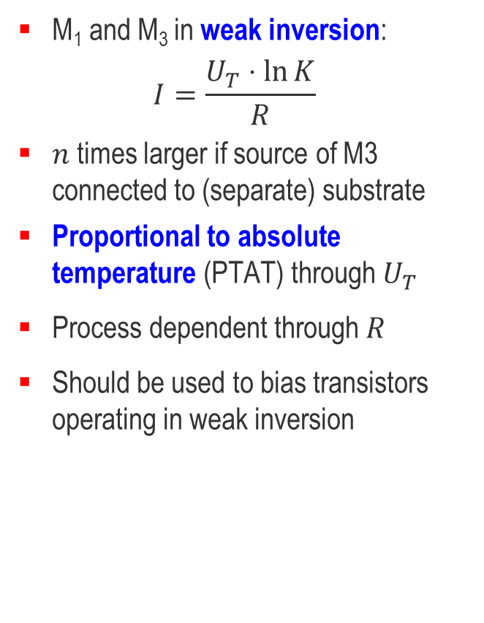
Current Generation – The Vittoz Current Reference
M₁ and M₃ in weak inversion:
$$I=\frac{U_{T}⋅\ln{K}}{R}$$
$n$ times larger if source of M3 connected to (separate) substrate
Proportional to absolute temperature (PTAT) through $U_{T}$
Process dependent through $R$
Should be used to bias transistors operating in weak inversion
M₁ and M₃ in strong inversion:
$$I=\frac{2{\left(\sqrt{K}−1\right)}^{2}}{n R^{2} β_{3}}$$
$n^{2}$ times larger if source of M3 connected to (separate) substrate
Process (and temperature) dependent through $R^{2}∙β_{3}$ term
Should be used to bias transistors operating in strong inversion

Slide 36
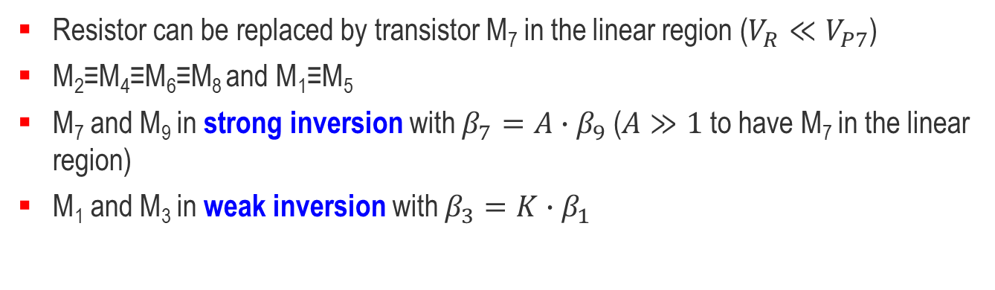
Current Generation – The Oguey Current Reference
Resistor can be replaced by transistor M₇ in the linear region ($V_{R}≪V_{P7}$)
M₂≡M₄≡M₆≡M₈ and M₁≡M₅
M₇ and M₉ in strong inversion with $β_{7}=A∙β_{9}$ ($A≫1$ to have M₇ in the linear region)
M₁ and M₃ in weak inversion with $β_{3}=K∙β_{1}$
H. J. Oguey and D. Aebischer, “CMOS Current Reference without Resistance,” JSSC, vol. 32, No. 7, July 1997.
C. C. Enz and E. A. Vittoz in Emerging technologies: Designing Low Power Digital Systems, R. Cavin and W. Liu, Eds. IEEE, 1996.
P. Heim, S. R. Schultz, and M. A. Jabri, Proc. Sixth Australian Conf. on Neural Networks, Sydney, Australia, 1995, pp. 9-12.

Slide 37
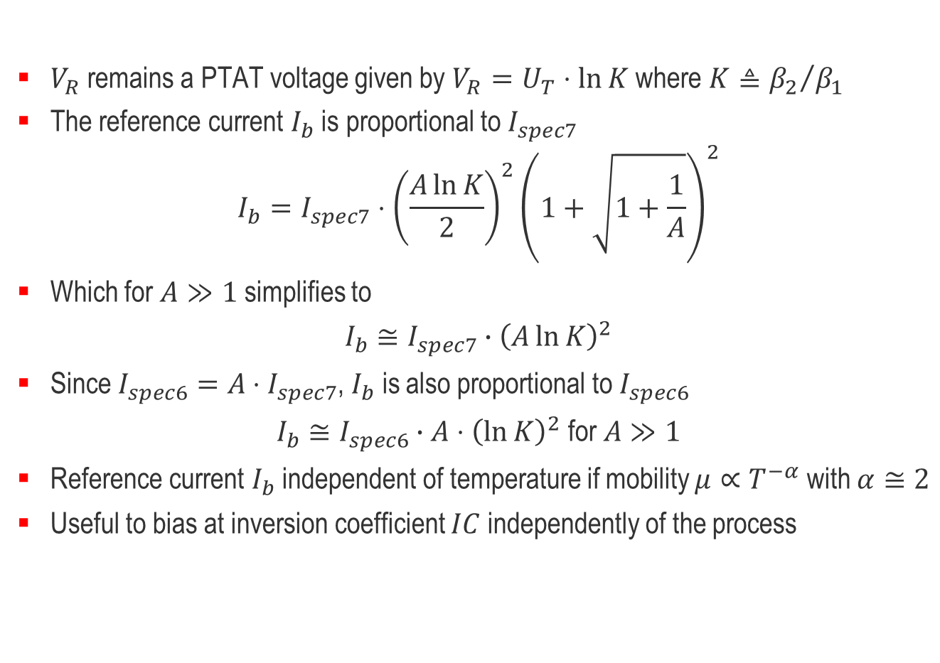
Current Generation – The Oguey Current Reference
$V_{R}$ remains a PTAT voltage given by $V_{R}=U_{T}⋅\ln{K}$ where $K≜{β_{2}}/{β_{1}}$
The reference current $I_{b}$ is proportional to $I_{spec7}$
$$I_{b}=I_{spec7}⋅{\left(\frac{A\ln{K}}{2}\right)}^{2}{\left(1+\sqrt{1+\frac{1}{A}}\right)}^{2}$$
Which for $A≫1$ simplifies to
$$I_{b}≅I_{spec7}∙{\left(A\ln{K}\right)}^{2}$$
Since $I_{spec6}=A⋅I_{spec7}$, $I_{b}$ is also proportional to $I_{spec6}$
$$I_{b}≅I_{spec6}∙A⋅{\left(\ln{K}\right)}^{2} \text{for} A≫1$$
Reference current $I_{b}$ independent of temperature if mobility $μ∝T^{−α}$ with $α≅2$
Useful to bias at inversion coefficient $IC$ independently of the process
H. J. Oguey and D. Aebischer, “CMOS Current Reference without Resistance,” JSSC, vol. 32, No. 7, July 1997.
C. C. Enz and E. A. Vittoz in Emerging technologies: Designing Low Power Digital Systems, R. Cavin and W. Liu, Eds. IEEE, 1996.
P. Heim, S. R. Schultz, and M. A. Jabri, Proc. Sixth Australian Conf. on Neural Networks, Sydney, Australia, 1995, pp. 9-12.

